Slide 1
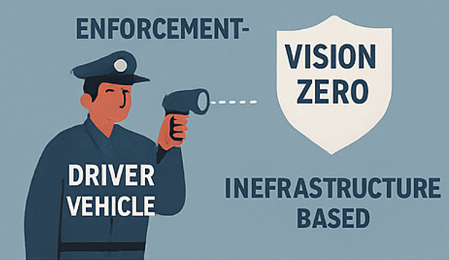
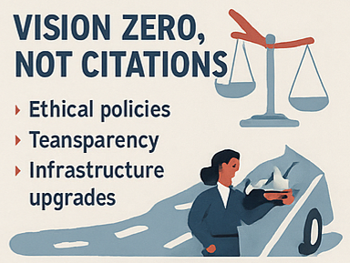
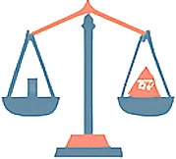
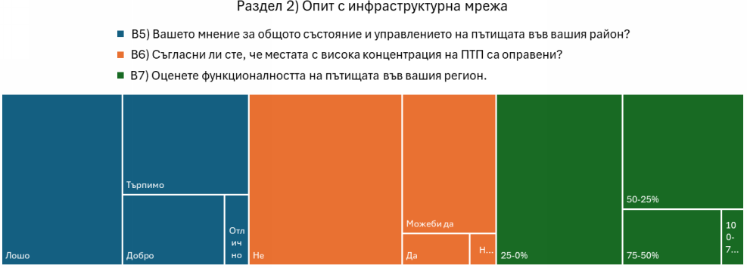
TAXATION BY CITATION, ONE OPTION TO ABUSE THE ROAD SAFETY IN BULGARIA
Metodiy Steliyanov
Varna Free University &
metodiy@abv.bg
Martina Georgieva
University of V.Tarnovo
yuliyanova.georgieva@gmail.com
THE PARADICM CLASH
VISION ZERO,NOT CITATIONS
‘Revenue-motivated policing’ and ‘taxation via citations’, Both of those practices are driven by the goal of generating revenue
rather than enforcing laws impartially and ensuring public safety.
Since the 1970s in Bulgaria there is a strong statement continuously supported by the governmental authorities that most of the traffic accidents occur due to the poor discipline of the driver.
One of the easiest ways for implementation is the use of mobile hidden cameras for speed control.
VISION ZERO METHOD PRIORITIZES ROAD DESIGN AND INFRASTRUCTURE ENHANCEMENTS
Fig. 1. Construction rate of new national roads in Bulgaria.
Vision Zero method prioritizes road design and infrastructure enhancements, which are underutilized in the Bulgarian context – where for the last sixteen years the country has been constructing 36.2 km, on average of new national roads.
FRICTION BETWEEN SAFETY AND REVENUE THREATENS EQUALITY BEFORE THE LAW
The poll shows that:
49% of participants rate the management of the road network as “Poor”.
62% of the accident-prone areas are not rectified by the road;
51% rated the efficiency of the network as overwhelmingly as poor.
Fig. 2. Volumetric representation of participants' network performance experiences.

